Slide 1
Raspberry Pi and .NET Core 3.1
Created and presented by
David Wilson
Staff Engineer at LendingTree
May 12, 2020

Slide 2
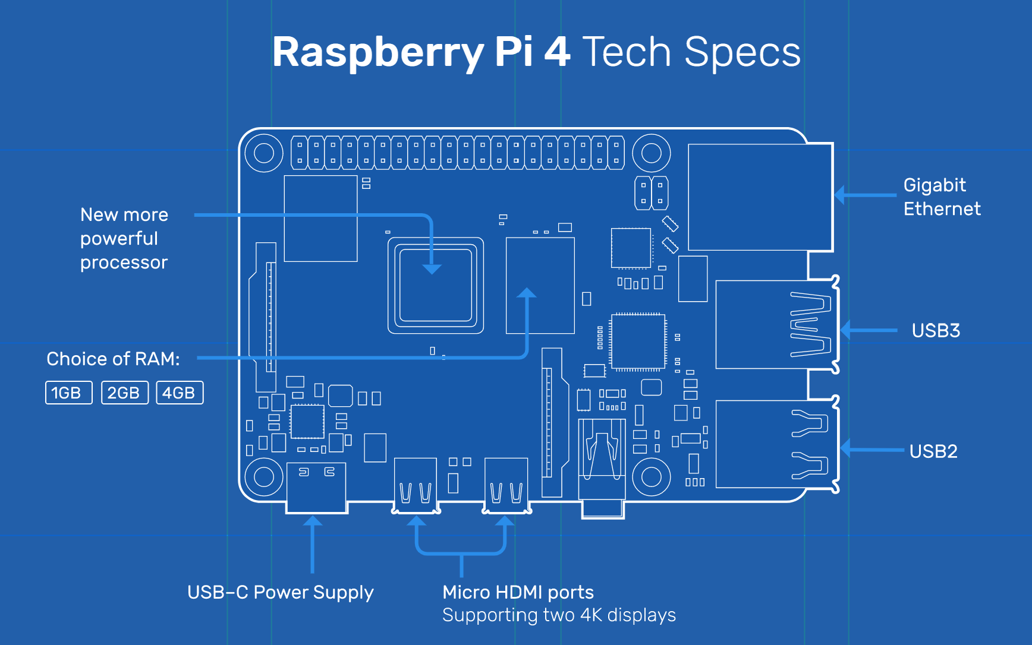
What is a Rasberry Pi 4?
Specifications:
Broadcom BCM2711, Quad core Cortex-A72 (ARM v8) 64-bit SoC @ 1.5GHz
1GB, 2GB or 4GB LPDDR4-3200 SDRAM (depending on model)
2.4 GHz and 5.0 GHz IEEE 802.11ac wireless, Bluetooth 5.0, BLE
Gigabit Ethernet
2 USB 3.0 ports; 2 USB 2.0 ports.
Raspberry Pi standard 40 pin GPIO header (fully backwards compatible with previous boards)
2 × micro-HDMI ports (up to 4kp60 supported)
2-lane MIPI DSI display port
2-lane MIPI CSI camera port
4-pole stereo audio and composite video port
H.265 (4kp60 decode), H264 (1080p60 decode, 1080p30 encode)
OpenGL ES 3.0 graphics
Micro-SD card slot for loading operating system and data storage
5V DC via USB-C connector (minimum 3A*)
5V DC via GPIO header (minimum 3A*)
Power over Ethernet (PoE) enabled (requires separate PoE HAT)
Operating temperature: 0 – 50 degrees C ambient
A good quality 2.5A power supply can be used if downstream USB peripherals consume less than 500mA in total.

Slide 3
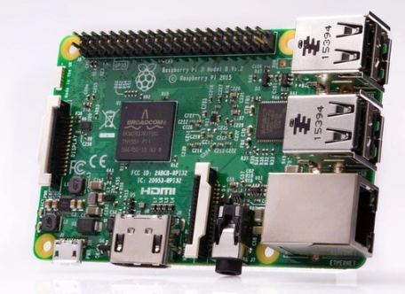
What about the Raspberry Pi 3B?
Specifications:
Quad Core 1.2GHz Broadcom BCM2837 64bit CPU
1GB RAM
BCM43438 wireless LAN and Bluetooth Low Energy (BLE) on board
100 Base Ethernet
40-pin extended GPIO
4 USB 2 ports
4 Pole stereo output and composite video port
Full size HDMI
CSI camera port for connecting a Raspberry Pi camera
DSI display port for connecting a Raspberry Pi touchscreen display
Micro SD port for loading your operating system and storing data
Upgraded switched Micro USB power source up to 2.5A

Slide 4


So it is like an Ariel Atom?
Like this?

Slide 5


No it is more like this
Sporty like but not a real sports car

Slide 6
Parts needed
RaspberryPi from Canary, etc.
MicroSD card 4 GB to 64 GB
Note if you get 64 or larger you will need to format it differently
SD Card official formatting tool - sdcard.org
Networking cable
Laptop or computer to download software and to connect to the Pi later
For “typical computer setup”
Monitor
Keyboard
Mouse
Notes:
6

Slide 7
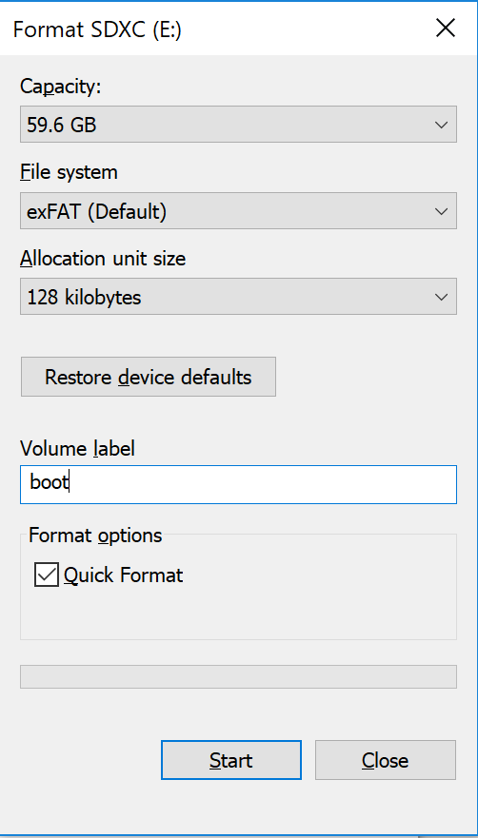
General Configuration for basic Raspberry Pi setup
Assemble the Raspberry Pi per instructions from your kit
Do not boot the PI until later
Download the OS from Raspbian Download.
The file size will be ~435 MB to 2.5 Gig depending on the version you choose.
Prepare the SD card
Insert MicroSD or SD adapter with MicroSD into your computer to begin formatting
Right click on the drive and click format
Select File system type. If greater than 32 GB then select exFAT
Give the drive/volume a label. I choose to call mine “boot”
Unzip the OS download from step 2
At the time of this writing the OS was kernel version 4.19 released in September 2019.
2019-09-26-Raspbian-buster-full.zip
Extract the image to your SD card. Installing Image
If you do not already have an image burning tool I suggest the baleanEtcher
Your SD card should not have a bootable image
Notes:
7

Slide 8
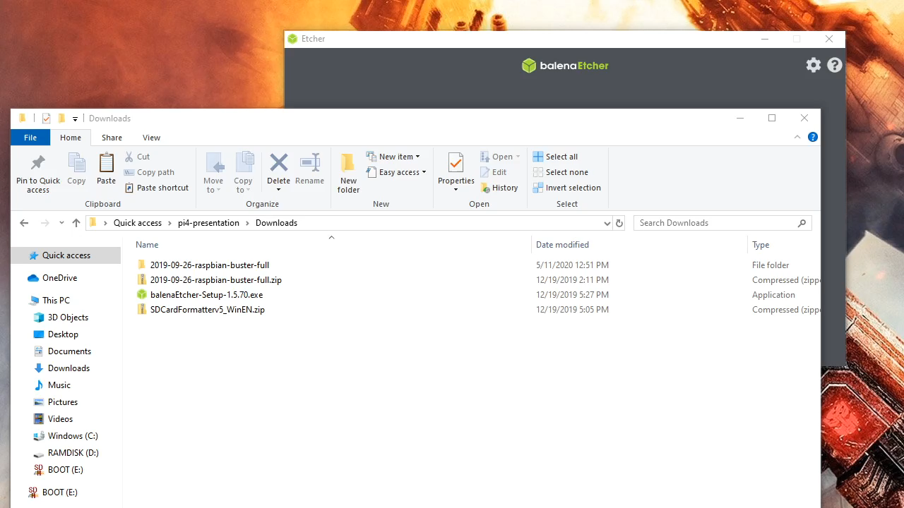
Burn Image with baleanEtcher
Notes:
8

Slide 9
Decision Time? Typical setup or headless?
This is completely up to you or what you have laying around…
“Typical” machine with keyboard, mouse and monitor
Right click on the SD card in Windows Explorer and select Eject
Remove SD card from your machine
Insert the microSD card into your Raspberry Pi
Plug in the hardware devices
Power up the Pi
Configure the Pi for headless access
If you do not have a spare monitor, keyboard and mouse you can still configure and be up and running with a headless setup.
The steps to complete a headless setup are longer than a slide presentation. To view those steps refer to here.

Slide 10
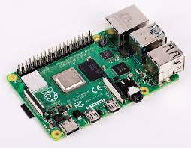
Complete basic setup of the Pi
Type: sudo raspi-config
Using your keyboard and arrows navigate to “Network options”
Select Wi-fi
Type in the SSID id/name that you want your Raspberry Pi to connect to
Type in the Wi-Fi password
Select finish to exit the configuration
Test the wifi by pinging a well-known address or website like www.google.com, etc.
Type: sudo raspi-config
Turn on ssh so that you can remote to it later
Select update to get the latest update for your Pi over the Wifi connection
Select finish to exit the configuration
Additional instructions for SD card and download: pi-setting-up
Official Raspberry Pi setup instruction: Official Instructions
Notes:
10

Slide 11

Let’s add some dotnet core
And now for the fun stuff!

Slide 12

Get some dotnet core goodness
Manual install required…
Since the Raspberry Pi is not an x64 processor but instead ARM v8 we cannot use the package manager…
Notes:
12

Slide 13
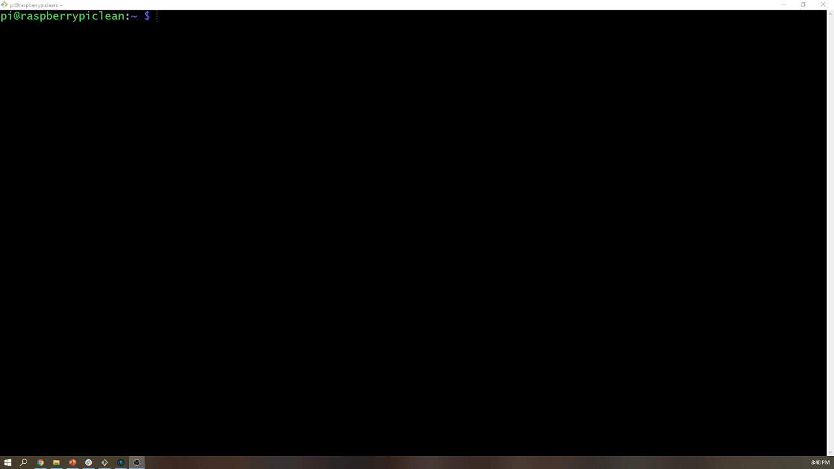
Update prerequisites
sudo apt-get update
sudo apt-get install curl libunwind8 gettext apt-transport-https
Notes:
13

Slide 14
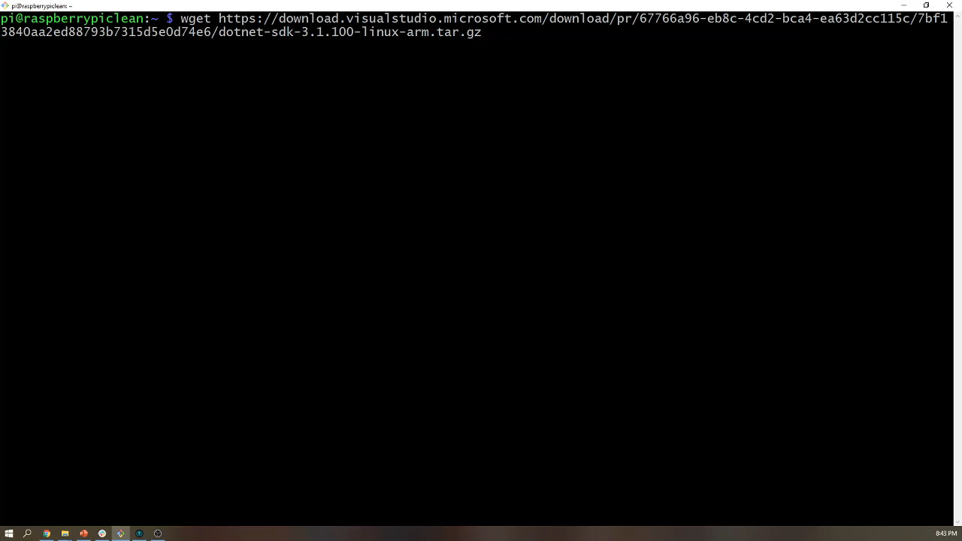
Download the sdk and runtime
wget https://download.visualstudio.microsoft.com/download/pr/67766a96-eb8c-4cd2-bca4-ea63d2cc115c/7bf13840aa2ed88793b7315d5e0d74e6/dotnet-sdk-3.1.100-linux-arm.tar.gz
wget https://download.visualstudio.microsoft.com/download/pr/8c839c0e-a5ae-4254-8d8b-c012528fe601/c147e26bad68f97eacc287a71e01331d/aspnetcore-runtime-3.1.0-linux-arm.tar.gz
Notes:
14

Slide 15
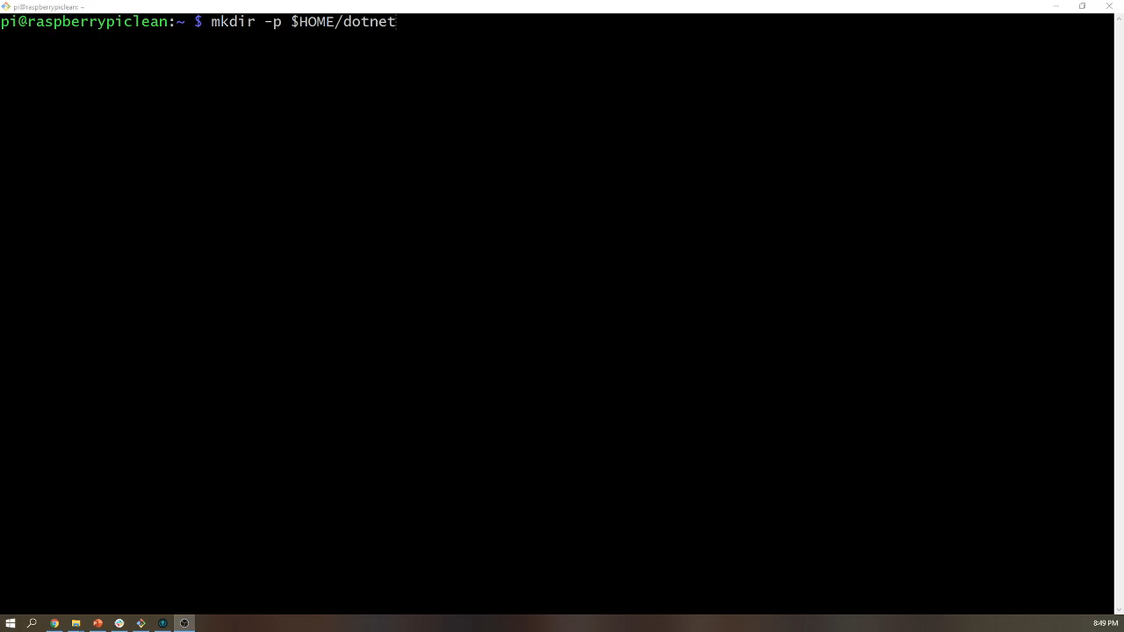
Extract the binaries
Make the installation directory. Type: mkdir –p $HOME/dotnet
Untar the sdk. Type: tar -zxvf dotnet-sdk-3.1.100-linux-arm.tar.gz -C $HOME/dotnet
Untar the runtime. Type: tar -zxvf aspnetcore-runtime-3.1.0-linux-arm.tar.gz -C $HOME/dotnet
Notes:
15

Slide 16

Wrap up the install
Configure your current connection/shell to have dotnet skd and runtime in the path Type:
export DOTNET_ROOT=$HOME/dotnet
export PATH=$PATH:$HOME/dotnet
Note: if you want to permanently keep the above in your path edit the .profile and add the following lines
DOTNET_ROOT=$HOME/dotnet
PATH=$PATH:$HOME/dotnet
Verify dotnet can be executed by typing:
dotnet --info
Notes:
16

Slide 17

Let’s create a sample application
Navigate to where you want your sample application to be created at
mkdir helloworld
cd helloworld
dotnet new console
dotnet build –r linux-arm
dotnet run –r linux-arm
Notes:
17

Slide 18

Let’s create a sample application
Navigate to where you want your sample application to be created at
mkdir helloworld
cd helloworld
dotnet new console
dotnet build –r linux-arm
dotnet run –r linux-arm
Notes:
18

Slide 19
What about a website?
Navigate to where you want your sample application to be created at
mkdir helloworldwebsite
dotnet new webapp
dotnet build -r linux-arm
dotnet run -r linux-arm
Note that by default the new site will run and listen on localhost on port 5000 (http) and 5001 (https).
If you want test out the website from another machine you will need to edit the Properties/launchSettings.json file. One option is to replace localhost with * for the application Url.
Playing with SSL
By default the dotnet template is configured to redirect the clients to https. If you want to turn this setting off during your troubleshooting or local development follow these steps:
Type: vi Startup.cs
Comment out app.UseHttpsRedirection();
Save and exit the text editor.
Recompile and run the application.
Notes:
19

Slide 20
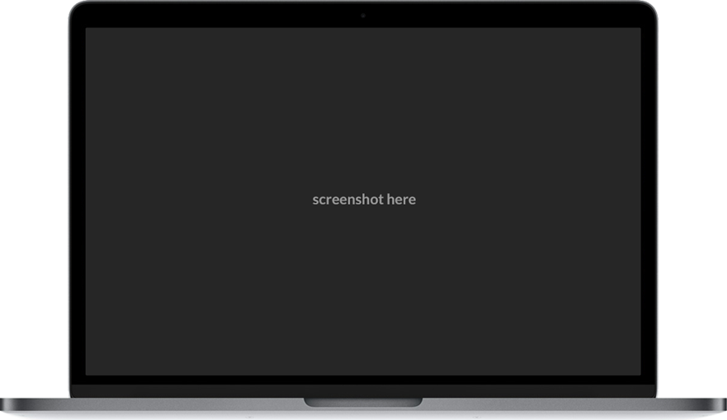
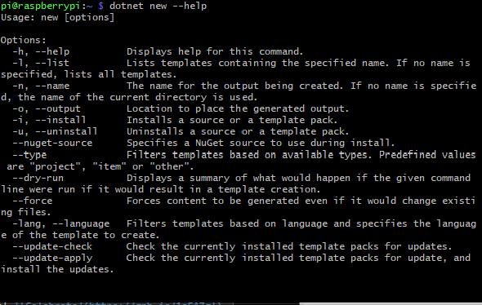
Exercise
Explore dotnet new command line
Now that you know how to create a sample dotnet core web site using the command line new command let's explore the new command.
dotnet new --help
Using the information shown with --help create a new web api project and get it running on your own.
Notes:
20

Slide 21
But how does this Pi perform?
Sample webapi site
Create a simple new api project
mkdir webapiPerformanceTest
cd webapiPerformanceTest
dotnet new webapi
Edit the Properties/launchSettings.json and replace localhost with * for the applicationUrl. This will allow testing from a different machine.
Edit the Startup.cs file and add app.UseStaticFiles(); before app.UseRouting();
The load testing tool that I used is Websurge which can be found here.
Websurge requires that you edit the robots.txt file or place an empty file called websurge-allow.txt in wwwroot. If wwwroot does not exist then create it.
Finally build, compile and run the application.
dotnet build –c Release –r linux-arm
dotnet run –c Release –r linux-arm
From your personal machine Websurge configure and run the tests.
Configure websurge with http GET of http://192.168.1.200:5000/weatherforecast
Make sure your turn off the progress info so that your test bed machine that is running websurge can perform more load on the Raspberry Pi.
Next

Slide 22
Websurge basic webapi performance results are…
Sample webapi site with wired connection local network laptop to pi4
Test 1 (5 threads, 10 seconds)
373 req/sec
0 failed
2.13 ms average
18 ms max
Test 3 (15 threads, 60 seconds)
1,124 req/sec
0 failed
67,436 total requests
2.02 ms average
29 ms max
Test 4 (50 threads, 120 seconds) – degraded
2,412 req/sec
49 failed
289,417 total requests
6.20 ms average
81,738 ms max
Test 2 (10 threads, 60 seconds)
741 req/sec
0 failed
44,438 total requests
2.20 ms average
59 ms max
Test 5 (100 threads, 120 seconds) – degraded
3,742 req/sec
0 failed
449,046 total requests
12.83 ms average
8,103 ms max

Slide 23
Websurge basic webapi performance results are…
Sample webapi site with localhost
Test 1 (5 threads, 10 seconds)
427 req/sec
0 failed
4,271 total requests
0.50 ms average
20 ms max
Test 3 (15 threads, 60 seconds)
1,265 req/sec
0 failed
79,400 total requests
0.60 ms average
35 ms max
Test 4 (50 threads, 120 seconds)
3,970 req/sec
0 failed
476,348 total requests
1.08 ms average
55 ms max
Test 2 (10 threads, 60 seconds)
833 req/sec
0 failed
49,981 total requests
0.69 ms average
34 ms max
Test 5 (100 threads, 120 seconds)
5,367 req/sec
0 failed
644,098 total requests
5.09 ms average
197 ms max

Slide 24
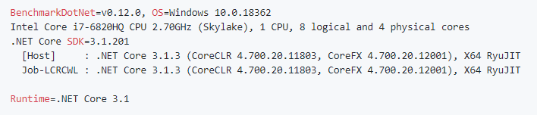
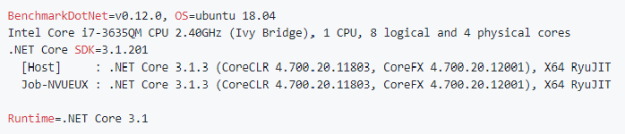
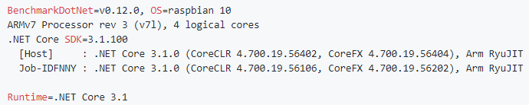
What about testing at a lower level?
For this performance test we are going to look at a series of simple string concatenation operations across three different machines.
The BenchmarkDotNet nuget package was used to perform the tests.
The three machines are:
Lenovo P50
Samsung Chronos7
Raspberry Pi4

Slide 25
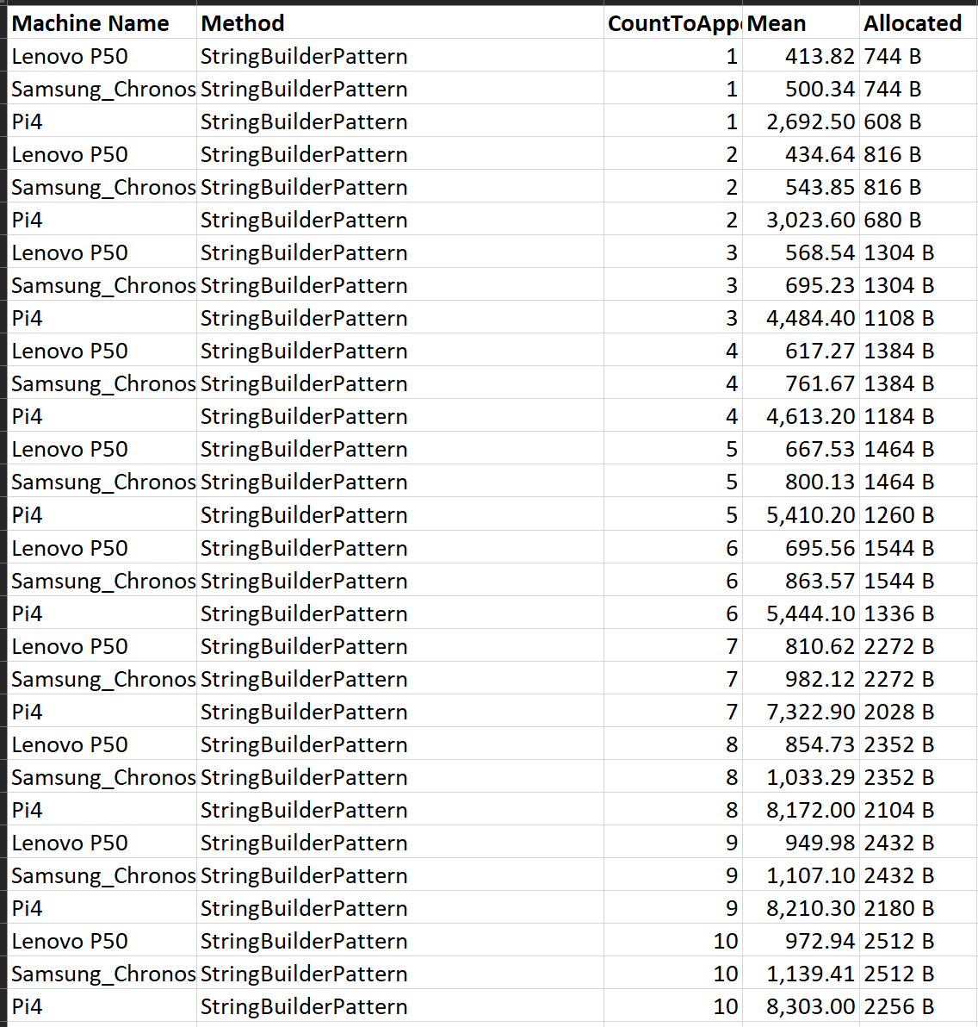
String Mutation Performance –StringBuilder

Slide 26
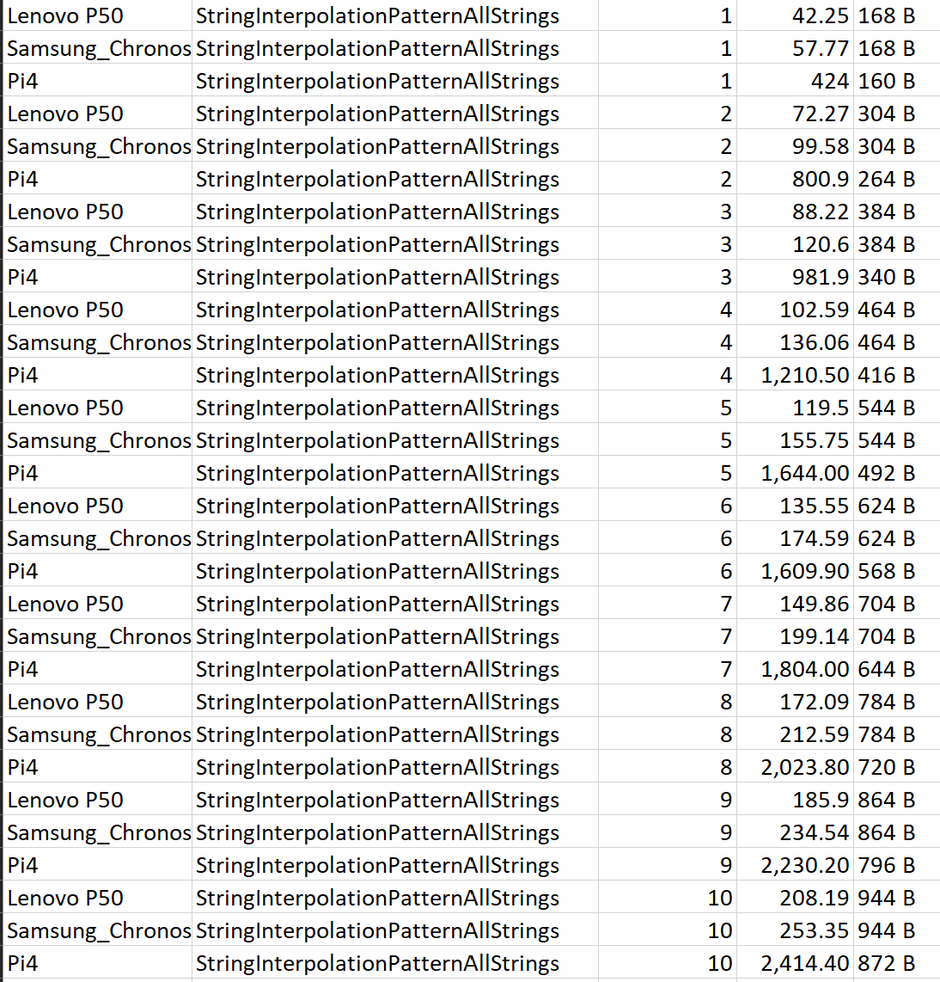
String Mutation Performance –String Interpolation All Strings

Slide 27
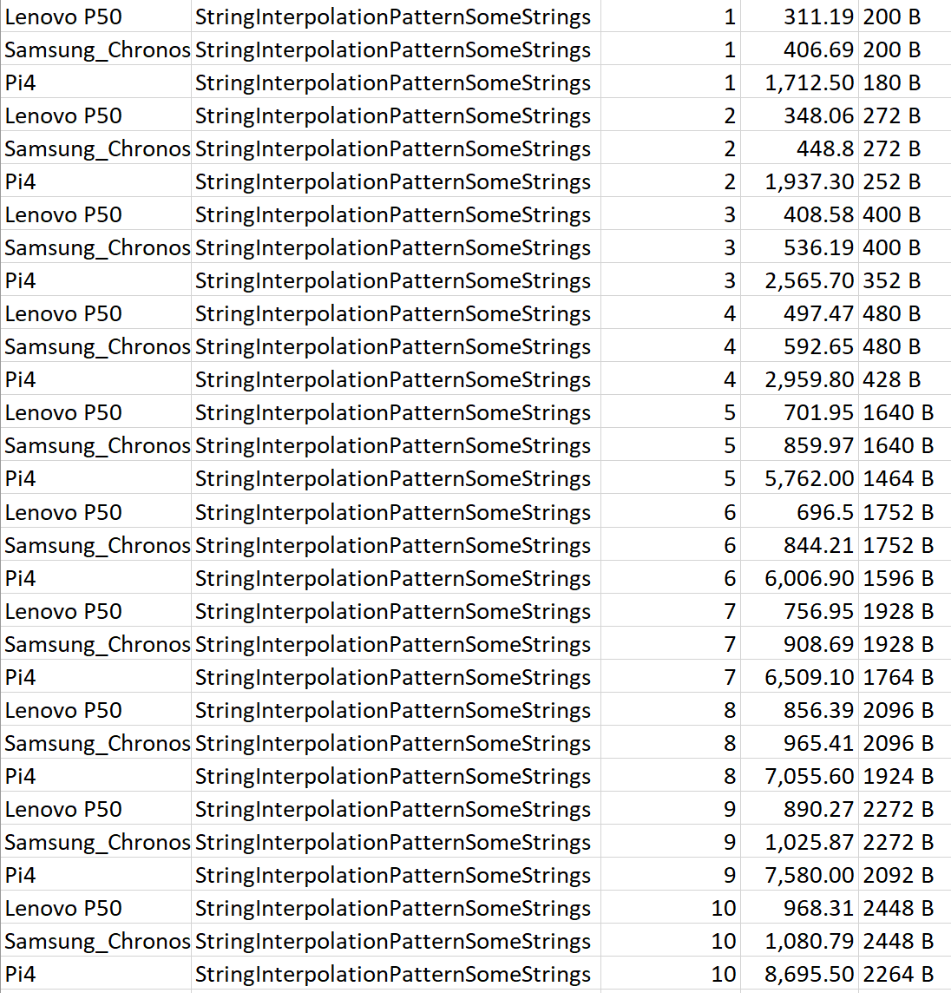
String Mutation Performance –String Interpolation Some Strings

Slide 28

What about testing at a lower level?
For this performance test we are going to look at a series of simple List<string> data sets and use the
BenchmarkDotNet nuget package to test several of the DotNet Api's search capabilities.
For fun we will also test a method I wrote that combines Parallel.ForEach with hand rolled chunking.
I wrote this method called with the assumption that I would not do better than Microsoft's dotnet core implementation of Parallel.ForEach. I did write several iterations of this and I even managed to waste a good amount of time by accidently breaking the logic on the out of bounds condition and on end of list condition.
I am sort of happy to say that given an hour of time I failed to do better than
the Microsoft engineers did.
Detailed results can be found at BenchmarkResults in the two directories,
one for each list size.

Slide 29
What about testing at a lower level?
Detailed results can be found at BenchmarkResults in the two directories,
one for each list size.
Let’s look at FindWithParallelFor and search for an item, Person666675 near the middle of the list for 1 million items.
Pi4: 26,064,827.8 ns
Chronos7: 5,061,684.11 ns
Lenovo: 7,503,909.62 ns
Again the results is that the Pi4 is about 4 to 5 times slower than the laptops.

Slide 30

More ad hock fun if time allows…
Install docker: https://github.com/eldiosyeldiablo/dotnetcore-3.1-raspberrypi-4-presentation/blob/master/docs/InstallDocker.md
Build on Windows10 machine and publish to the Pi: https://github.com/eldiosyeldiablo/dotnetcore-3.1-raspberrypi-4-presentation/blob/master/docs/RunPublishedDotNetCoreApp.md
Test using TechEmpower Benchmarks: https://github.com/eldiosyeldiablo/dotnetcore-3.1-raspberrypi-4-presentation/blob/master/docs/RunTechEmpowerBenchmarks.md
Install VS Code on the Pi: https://www.hanselman.com/blog/HowToInstallVisualStudioCodeOnARaspberryPi4InMinutes.aspx

Slide 31
Conclusions
Can you run your dotnet web apis on an Raspberry Pi4?
Yes!
Should you?
It depends.
It depends on your expected load and your budget
If you want a minimal investment, then $50 is all you need
Notes:
31

Slide 32

Questions?
Will there be answers?
Unknown at this time…
Notes:
32

Slide 33
Thank you

